Slide 1

COMP 90049
Knowledge Technologies
Week 9
我们毕业啦
其实是答辩的标题地方
Tutor
Ang Li

Slide 2
Name: Ang Li
E-mail: angl4@student.unimelb.edu.au
Contact information
Research topic: computer vision

Slide 3
Summery
Work through this week’s exercise
Notes:
Secure File Transfer Protocol
Secure Shell

Slide 4
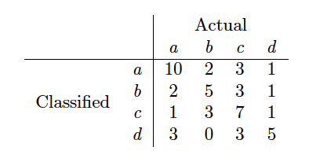
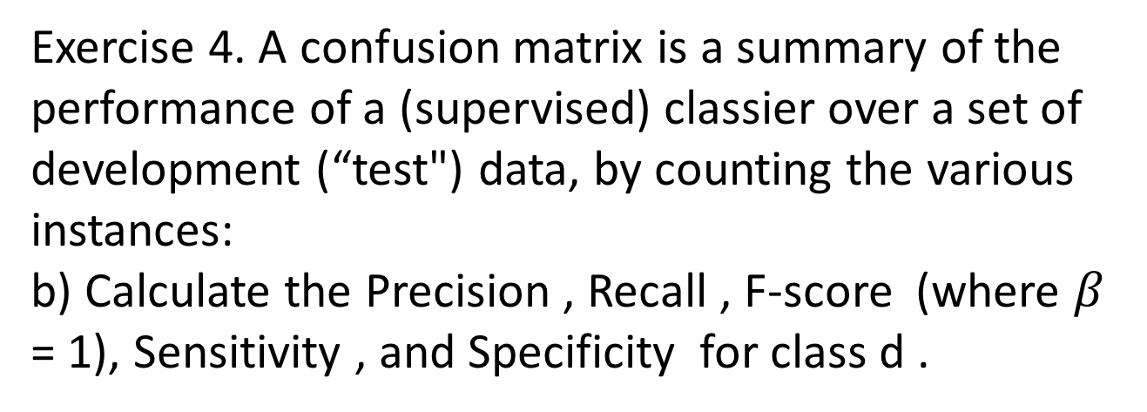
Exercise 4. A confusion matrix is a summary of the performance of a (supervised) classier over a set of
development (“test") data, by counting the various instances:
b) Calculate the Precision , Recall , F-score (where $β$ = 1), Sensitivity , and Specificity for class d .

Slide 5
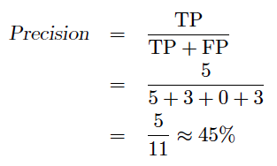
Precision for a given class is defined as the fraction of correctly identified instances of that class.
The true positives (TP) where we attempted to classify an item as an instance of the said class (here, d), and it was actually of that class (d ), there are 5 here.
The false positives (FP) are those items that we attempted to classify as being of class d , but they were actually of some other class: there are 3 + 0 + 3 = 6

Slide 6
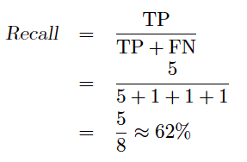
Recall for a given class is dened as the fraction of correctly identified instance of that class.
The true positives (TP) where we attempted to classify an item as an instance of the said class (here, d), and it was actually of that class (d ), there are 5 here
The false negatives (FN): those items that were actually of class d , but we classied as being of some other class; there are 1 + 1 + 1 = 3

Slide 7

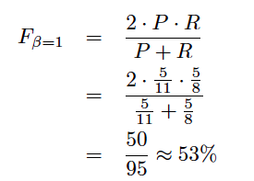
F-score is a measure which attempts to combine Precision (P) and Recall (R) into a single score.

Slide 8
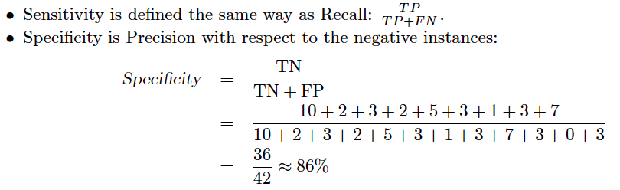

Slide 9
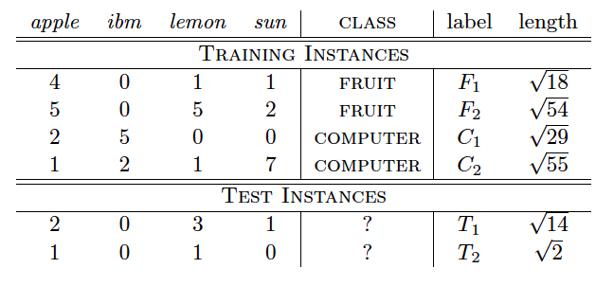
Exercise 1.
(b) Using the cosine similarity measure, classify the test instances using the 3-NN method.

Slide 10
KNN
Classify the test input according to the majority class of the k nearest training instances.

Slide 11
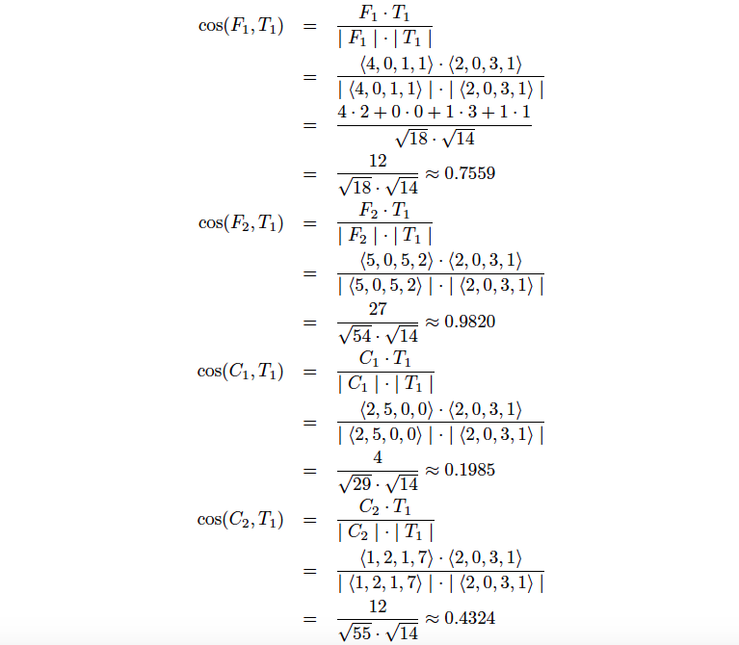

Slide 12
We're looking for the 3 best nearest neighbours: for the cosine measure, these are the instance with the greatest values. For T1 , this is F2 with a score of 0: 9820, and F1 and C2 .
Two of the 3-best neighbours are of class fruit , whereas only one is of class computer : we apply a voting procedure, and here fruit (with 2) out-votes computer (with 1), so we classify T1 as fruit .

Slide 13
What if we were using “weighted" k -nearest neigbour? Well, each of the k best neighbours gets a weighted vote, according to the cosine similarity score we calculated above. We then accumulate these weighted votes, and the class with the greater weighting is the one that we choose.
In this case, fruit has a total weight of 1.7379 (from F2 and F1 ) and computer only 0.4324 (from C2 ), so we choose fruit .

Slide 14
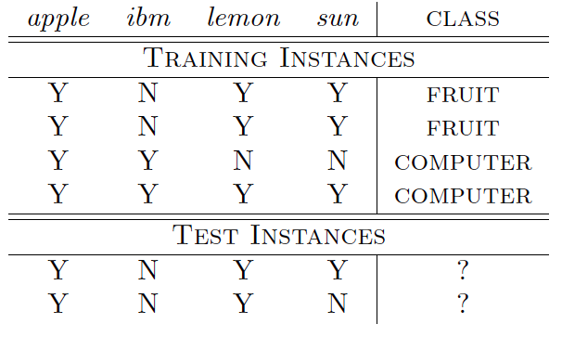
Exercise 2.
Use the method of Naive Bayes classification to classify the test instances. Revise some of the assumptions that are built into the model.

Slide 15
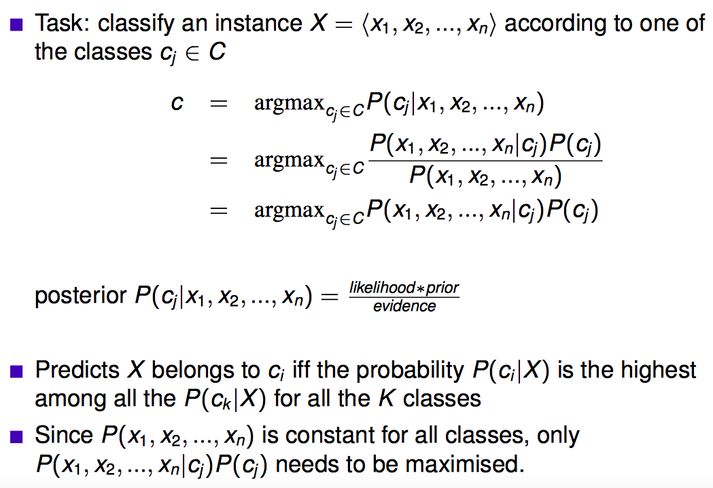

Slide 16
The assumption most central to the formulation of the Naive Bayes classier that we have discussed is the conditional independence assumption:
each attribute is independent to all of the other attributes, given the class under consideration.

Slide 17
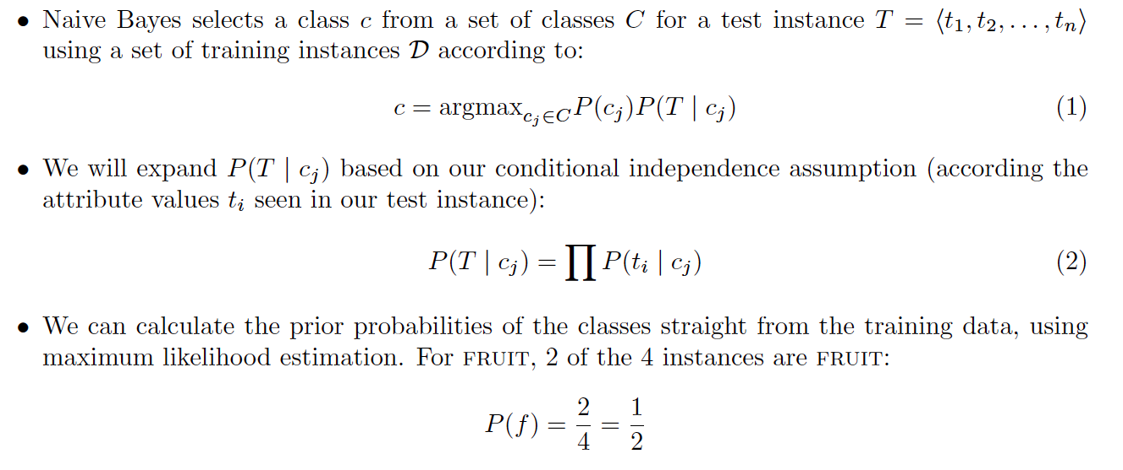

Slide 18
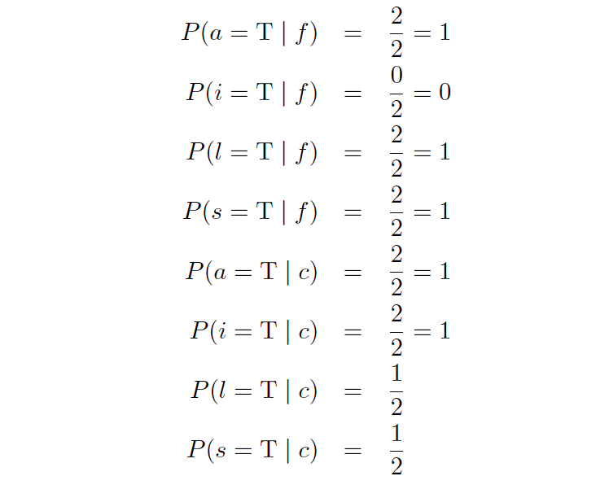

Slide 19
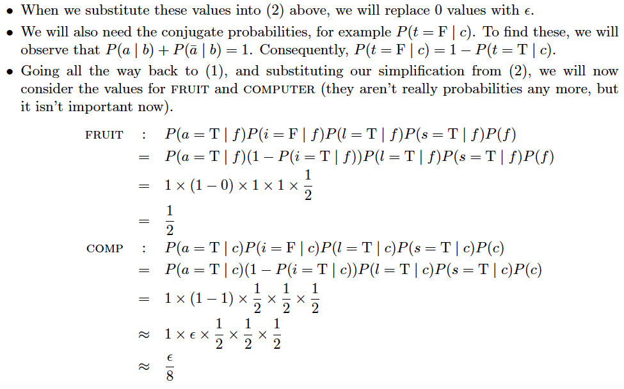

Slide 20
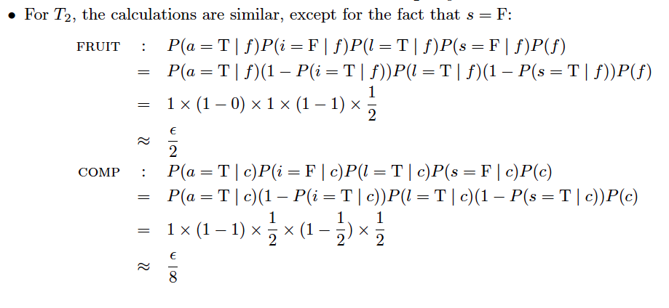

Slide 21
Thanks!

